Slide 2
Definitions of Data Mining
The discovery of new information in terms of patterns or rules from vast amounts of data.
The process of finding interesting structure in data.
The process of employing one or more computer learning techniques to automatically analyze and extract knowledge from data.

Slide 3
Data Warehousing
The data warehouse is a historical database designed for decision support.
Data mining can be applied to the data in a warehouse to help with certain types of decisions.
Proper construction of a data warehouse is fundamental to the successful use of data mining.

Slide 4
Knowledge Discovery in Databases (KDD)
Data mining is actually one step of a larger process known as knowledge discovery in databases (KDD).
The KDD process model comprises six phases
Data selection
Data cleansing
Enrichment
Data transformation or encoding
Data mining
Reporting and displaying discovered knowledge

Slide 5
Goals of Data Mining (PICO)
Prediction:
Determine how certain attributes will behave in the future.
Identification:
Identify the existence of an item, event, or activity.
Ex: identify certain pattern using data pattern
Classification:
Partition data into classes or categories. (Food: Party Food, School Lunch, Healthy Food)
Optimization: (Objective Function)
Optimize the use of limited resources (time, space, money).

Slide 6
Types of Discovered Knowledge
The result of DM may be to discover the following type of new information
Association Rules
Classification Hierarchies
Sequential Patterns
Patterns Within Time Series
Clustering

Slide 7
Association Rules
Association rules are frequently used to generate rules from market-basket data. Ex: Beers and Diapers;
A market basket corresponds to the sets of items a consumer purchases during one visit to a supermarket.
The set of items purchased by customers is known as an itemset.
An association rule is of the form X=>Y, where X ={x₁, x₂, …., x_{n} }, and Y = {y₁,y₂, …., y_{n}} are sets of items, with x_{i} and y_{i} being distinct items for all i and all j.
For example: Buy Camera => Buy Accessories
For an association rule to be of interest, it must satisfy a minimum support and confidence.
Discount on Shampoo generates sales on Conditional

Slide 8
Association Rules Confidence and Support
Support:
The minimum percentage of instances in the database that contain all items listed in a given association rule.
Support is the percentage of transactions that contain all of the items in the itemset, LHS U RHS.
Confidence:
Given a rule of the form A=>B, rule confidence is the conditional probability that B is true when A is known to be true.
Confidence can be computed as
support(LHS U RHS) / support(LHS)
Ex: bought milk and juice together (2 times)/bought milk (3 times) therefore, the confidence is 2/3 = 66.7% (Fig. 28.1 pg 1040) It means that, of 3 transactions in which milk occurs, two contain juice

Slide 9
Generating Association Rules
The goal of this rule is to generate all possible rules that exceed some min. support and confidence thresholds.
The general algorithm for generating association rules is a two-step process.
Generate all itemsets that have a support exceeding the given threshold. Itemsets with this property are called large or frequent itemsets.
Generate rules for each itemset as follows:
For itemset X and Y a subset of X, let Z = X – Y;
If support(X)/Support(Z) > minimum confidence, the rule Z (aka (X-Y) ) =>Y is a valid rule.

Slide 10
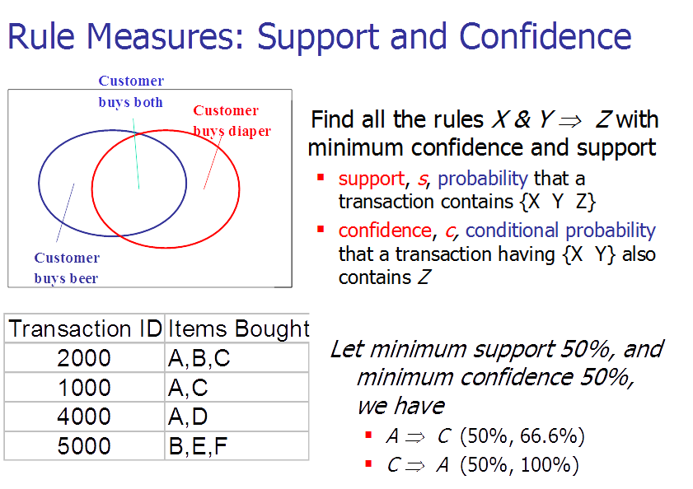

Slide 11
Reducing Association Rule Complexity
Two properties are used to reduce the search space for association rule generation.
Downward Closure
A subset of a large itemset must also be large
Anti-monotonicity
A superset of a small itemset is also small. This implies that the itemset does not have sufficient support to be considered for rule generation.

Slide 12
Generating Association Rules: The Apriori Algorithm
The Apriori algorithm was the first algorithm used to generate association rules.
The Apriori algorithm uses the general algorithm for creating association rules together with downward closure and anti-monotonicity.

Slide 13
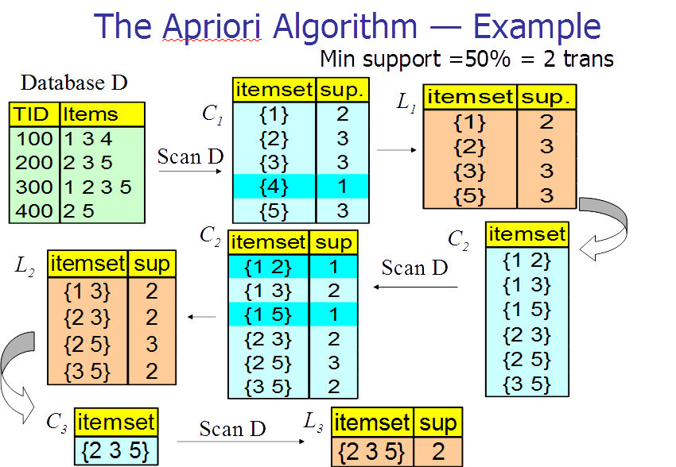

Slide 14
Generating Association Rules: The Sampling Algorithm
The sampling algorithm selects samples from the database of transactions that individually fit into memory. Frequent itemsets are then formed for each sample.
If the frequent itemsets form a superset of the frequent itemsets for the entire database, then the real frequent itemsets can be obtained by scanning the remainder of the database.
In some rare cases, a second scan of the database is required to find all frequent itemsets.

Slide 15
Generating Association Rules: Frequent-Pattern Tree Algorithm
The Frequent-Pattern Tree Algorithm reduces the total number of candidate itemsets by producing a compressed version of the database in terms of an FP-tree.
The FP-tree stores relevant information and allows for the efficient discovery of frequent itemsets.
The algorithm consists of two steps:
Step 1 builds the FP-tree.
Step 2 uses the tree to find frequent itemsets.

Slide 16
Step 1: Building the Frequent Pattern Tree (FP-Tree)
First, frequent 1-itemsets along with the count of transactions containing each item are computed.
The 1-itemsets are sorted in non-increasing order.
The root of the FP-tree is created with a “null” label.
For each transaction T in the database, place the frequent 1-itemsets in T in sorted order. Designate T as consisting of a head and the remaining items, the tail.
Insert itemset information recursively into the FP-tree as follows:
if the current node, N, of the FP-tree has a child with an item name = head, increment the count associated with N by 1 else create a new node, N, with a count of 1, link N to its parent and link N with the item header table.
if tail is nonempty, repeat the above step using only the tail, i.e., the old head is removed and the new head is the first item from the tail and the remaining items become the new tail.

Slide 17
Step 2: The FP-growth Algorithm For Finding Frequent Itemsets
Input: Fp-tree and minimum support, mins
Output: frequent patterns (itemsets)
procedure FP-growth (tree, alpha);
Begin
if tree contains a single path P then
for each combination, beta of the nodes in the path
generate pattern (beta U alpha)
with support = minimum support of nodes in beta
else
for each item, i, in the header of the tree do
begin
generate pattern beta = (i U alpha) with support = i.support;
construct beta’s conditional pattern base;
construct beta’s conditional FP-tree, beta_tree;
if beta_tree is not empty then
FP-growth(beta_tree, beta);
end;
End;

Slide 18
Generating Association Rules: The Partition Algorithm
Divide the database into non-overlapping subsets.
Treat each subset as a separate database where each subset fits entirely into main memory.
Apply the Apriori algorithm to each partition.
Take the union of all frequent itemsets from each partition.
These itemsets form the global candidate frequent itemsets for the entire database.
Verify the global set of itemsets by having their actual support measured for the entire database.

Slide 19
Complications seen with Association Rules
The cardinality of itemsets in most situations is extremely large.
Association rule mining is more difficult when transactions show variability in factors such as geographic location and seasons.
Item classifications exist along multiple dimensions.
Data quality is variable; data may be missing, erroneous, conflicting, as well as redundant.

Slide 20
Classification
Classification is the process of learning a model that is able to describe different classes of data.
Learning is supervised as the classes to be learned are predetermined.
Learning is accomplished by using a training set of pre-classified data.
The model produced is usually in the form of a decision tree or a set of rules.
Ex: A population may be divided into 5 ranges of credit worthiness based on past activities

Slide 21
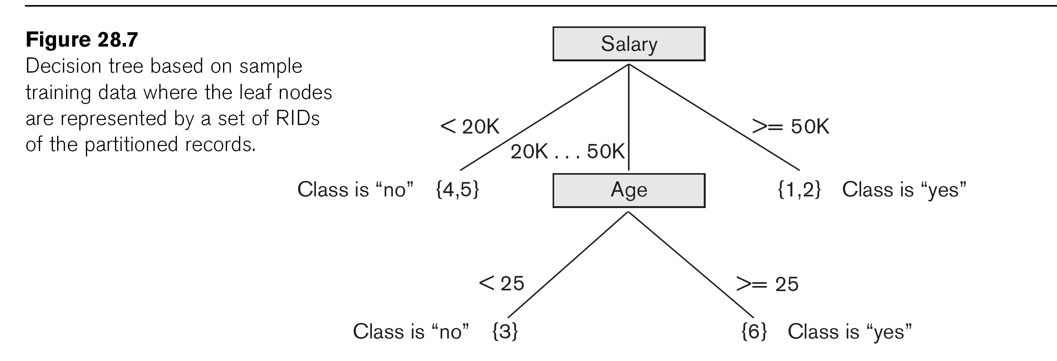

Slide 22
An Example Rule
Here is one of the rules extracted from the decision tree of Figure 28.7.
IF 50K > salary >= 20K
AND age >=25
THEN class is “yes”

Slide 23
Clustering
Unsupervised learning or clustering builds models from data without predefined classes.
The goal is to place records into groups where the records in a group are highly similar to each other and dissimilar to records in other groups.
The k-Means algorithm is a simple yet effective clustering technique.

Slide 24
Additional Data Mining Methods
Sequential pattern analysis
Time Series Analysis
Regression
Neural Networks
Genetic Algorithms

Slide 25
Sequential Pattern Analysis
Transactions ordered by time of purchase form a sequence of itemsets.
The problem is to find all subsequences from a given set of sequences that have a minimum support.
The sequence S₁, S₂, S₃, .. is a predictor of the fact that a customer purchasing itemset S₁ is likely to buy S₂ , and then S₃, and so on.
Ex: S1: bought 2 items during recession
prediction: S2: will buy at least 1 item at boom time.

Slide 26
Time Series Analysis
Time series are sequences of events. For example, the daily sales figure; the closing price of a stock is an event that occurs each day of the week.
Time series analysis can be used to identify the price trends of a stock or mutual fund.
Time series analysis is an extended functionality of temporal data management.

Slide 27
Regression Analysis
A regression equation estimates a dependent variable using a set of independent variables and a set of constants.
The independent variables as well as the dependent variable are numeric.
A regression equation can be written in the form Y=f(x₁,x₂,…,x_{n}) where Y is the dependent variable.
If f is linear in the domain variables x_{i}, the equation is call a linear regression equation.

Slide 28
Neural Networks
A neural network is a set of interconnected nodes designed to imitate the functioning of the brain.
Node connections have weights which are modified during the learning process.
Neural networks can be used for supervised learning and unsupervised clustering.
The output of a neural network is quantitative and not easily understood.

Slide 29
Genetic Learning
Genetic learning is based on the theory of evolution.
An initial population of several candidate solutions is provided to the learning model.
A fitness function defines which solutions survive from one generation to the next.
Crossover, mutation and selection are used to create new population elements.

Slide 30
Data Mining Applications
Marketing
Marketing strategies and consumer behavior
Finance
Fraud detection, creditworthiness and investment analysis
Manufacturing
Resource optimization
Health
Image analysis, side effects of drug, and treatment effectiveness

Slide 31
Recap
Data Mining
Data Warehousing
Knowledge Discovery in Databases (KDD)
Goals of Data Mining and Knowledge Discovery
Association Rules
Additional Data Mining Algorithms
Sequential pattern analysis
Time Series Analysis
Regression
Neural Networks
Genetic Algorithms

